Slide 1
Week 8
Criminological Theories of Computer Crime

Slide 2
What is a criminological theory?
A branch of philosophy – Philosophy of Law.
Deviant or Criminal behavior
Retribution, punishment, rehabilitation
Impact on society, social control
Morality and conscience

Slide 3
What is a criminological theory?
Broken into different “schools” of thought:
Classical School “Punishment is a deterrent to crime.”
Positivist School – “Punishment should fit the criminal, not the crime.”
Social-Structural School – “Punishment should fit the interests of society.”
Keep in mind that there is no one unifying theory of crime.

Slide 4
Theories of Crime
Individuals can be unpredictable, erratic, possibly dangerous. However, the farther you get away from an individual, the more predictable humans become.
A theory does not attempt to explain ALL crime – some are more applicable to some offenses (or offenders) than others.

Slide 5
Theories of Crime
Among theories there are MACRO and MICRO theories.
Different types of crime tend to have similarities, and so there are theories that can be applied to generalize OFFENSES.
At the same time, there may be many different reasons a person might commit a crime. Think theft – for survival, for infamy, for material gain. In these cases, theories are sometimes better applied to OFFENDER rather than offense.

Slide 6
Theories
There are theories we will cover in class that best describe various common computer crimes:
Routine activities theory
General strain theory
Broken windows theory
Social learning theory
Space-Transition Theory
When talking about theories keep in mind the unique environment of the Internet, separate from traditional society:
Anonymity
Constant connectivity
Permanence
Depersonalization

Slide 7
Routine Activities Theory
Developed by Marcus Felson and Lawrence Cohen post-WWII
Does not include any social causes for crime – poverty, inequity, systemic social ills are not part of the process.

Slide 8
Routine Activities Theory
These things must coincide in time and space to present an opportunity for criminal activity to take place.
A motivated offender.
A suitable target.
The absence of a capable guardian.

Slide 9
A Motivated Offender
A motivated offender is someone that is not only capable of committing a crime, but willing to do so.
They have the technical capability
They may not be actively seeking a victim, but are willing to take advantage of an opportunity to victimize
Likely have offended before, in some way
Computer crimes have the additional factors:
Automation
Low transaction cost for crime
Relative anonymity

Slide 10
A Suitable Target
A suitable target is a person or object that is (or is seen as) vulnerable or a particularly attractive target.
Present an opportune reward
Uniquely attractive target
Seen as “low-hanging fruit.”
Often taken advantage of in the form of a “honeypot” or impersonating a victim

Slide 11
A Capable Guardian
A person or thing that has been put in place to deter motivated offenders from victimizing suitable targets.
On the Internet this takes the form of both law enforcement and digital right management technology.
More difficult on the Internet since a capable guardian cannot be everywhere at every time, no matter how much detection is automated

Slide 12
Routine Activities Example
Acme Unlimited has various high-level users with access to highly sensitive data. – A suitable target (users and company.)
A hacker working in a criminal organization seeks privileged access to a company for the purposes of exfiltration and encrypting data. – A motivated offender
The hacker sends phishing emails to every user on a purchased list. A user from Acme Unlimited responds. A scan on Acme for vulnerabilities finds lapses in security. – The absence of a capable guardian.

Slide 13
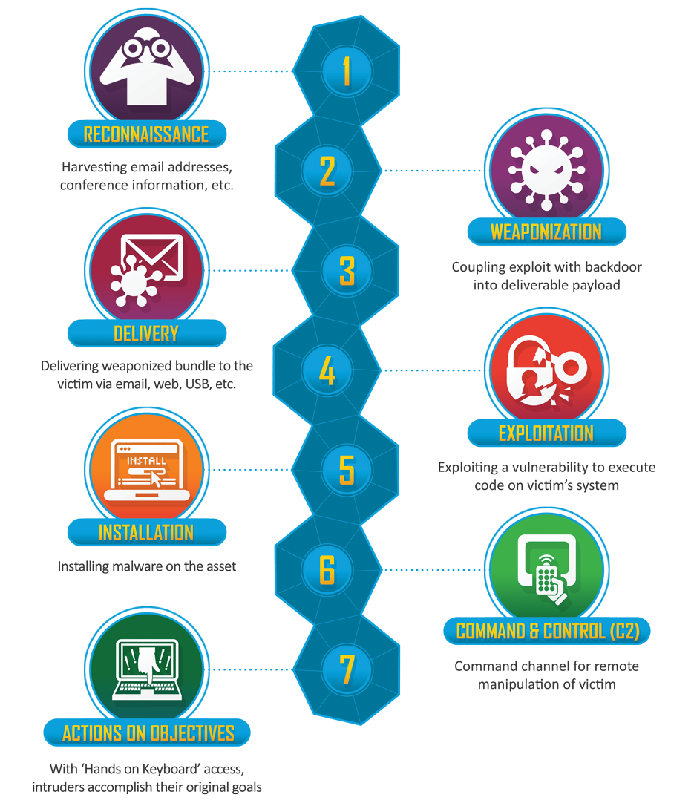
The cyber-attack kill chain

Slide 14
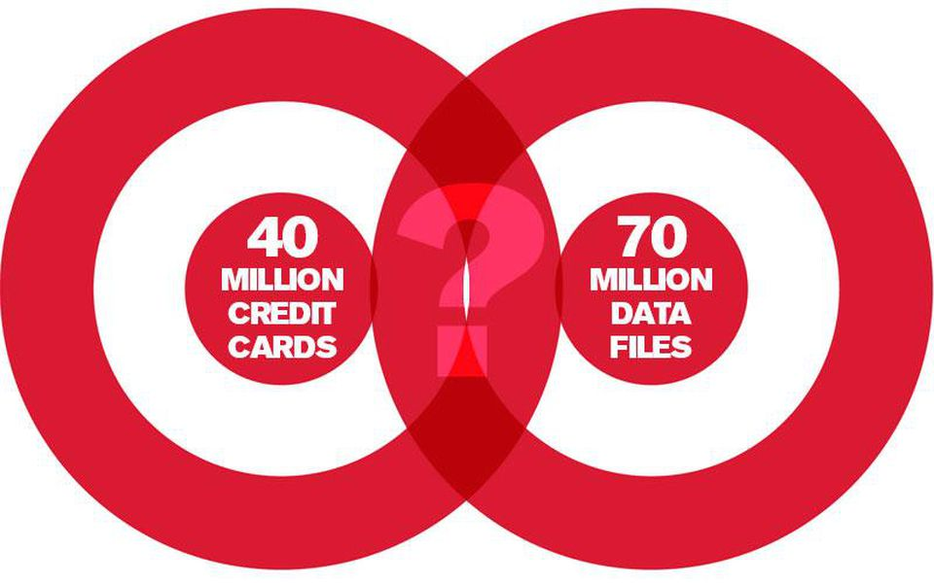
Target
Look at Routine Activities and the attack kill-chain from the case study of the 2013 Target breach.

Slide 15
The cyber-attack kill chain
Recon – Often using OSINT (Open Source Intelligence). White papers, indexes results, directories, vendors, etc.
Attackers discovered a white paper on the Internet published by Microsoft detailing Target’s Hyper-V infrastructure.
Attackers discover contractor portal on the public Internet.

Slide 16
The cyber-attack kill chain
Weaponization – Once a vector as been identified, the decision on approach. Exploit + backdoor = payload.
Attackers identify Target HVAC vendor Fazio Mechanical Services.
Custom-crafted malware is written for Target’s POS machines, a variant of Zeus.
Delivery – Payload reaches target by chosen means (phish, drops, etc.)
Fazio is phished, given the attackers credentials to access the vendor portal.

Slide 17
The cyber-attack kill chain
Exploitation – Payload execution, foothold gained.
Once access to the vendor portal is gained, attackers use previous intel to pivot through a vulnerable domain controller. The white paper indicates that only a few systems were shared among all Target stores – authentication and software distribution.
Installation – Attacker installs malware on the target.
Once ingress is achieved via domain controller exploit, attackers use SCCM to install malware on every point of sale machine.

Slide 18
The cyber-attack kill chain
Command and Control – Attacker is in communication with the compromised target.
The malware scrapes data from primary memory and uses ping messages with custom text to inform attackers it’s working.
Data is stored in .dll files and held in temporary NetBIOS shares on an internal server running BMC.

Slide 19
The cyber-attack kill chain
Actions on Objectives – All the pieces in place, the attacker does their work until complete or discovered.
Alerts from FireEye are ignored by Target. Exfiltration was noticed.
Attackers use default creds for BMC for Microsoft to grab data.

Slide 20
Broken Windows Theory
A micro theory of crime that applies well to the Internet, but especially to the so-called “victimless” crimes like piracy and online drug trafficking.
Proposed by James Wilson and George Kelling in the 1980s.
Also of the classical/neo-classical school
Works well with Routine Activities, which explains the HOW of crime while Broken Windows / Rational Choice explains the WHY

Slide 21
Broken Windows Theory
“A wrong gone unpunished encourages more wrongs.”

Slide 22
Broken Windows Theory
The micro version of the theory has shown to be more valid:
A disorderly behavior, without apparent consequences, implicitly encourages that behavior by displaying the lack of capable guardian.
This also means there is no apparent victim to the crime – it is “harmless.”

Slide 23
Broken Windows Example
Within your group of friends at school is a girl name Mary who often entertains guests in her dorm room. She always seems to have new newest Top 40 tracks in her playlist. She says she just downloads them on the internet.
Your skeptical at first because you know it’s illegal, but Mary never ends up getting caught and it’s not like it’s REALLY stealing… Then you find out your brother also pirates music, games, movies, etc.
Then you read in the news that 70% of people in your age group pirate all the time. That’s a lot of broken windows.

Slide 24
General Strain Theory
A theory that describes that human behavior is motivated by “strains” which we respond to – negative or positive.
Built off of a theory by Robert Merton, developed by Robert Agnew.
Described that there are four strains that likely lead to criminal behavior:
1) Strains seen as unjust.
2) Strains are high in magnitude.
3) Strains associated with low social control.
4) Strains that create pressure or incentive to engage in criminal coping.

Slide 25
General Strain Theory
Those suffering from this may seek “criminal coping”
Seeking quick profit to “keep up” with the appearance of wealth. For example, theft.
Getting revenge on those they see as the causes of strain. For example, harassment/assault.
Taking their frustration out on others as a way of alleviating these bad feelings. For example, cyber-bullying.
Explains computer crimes that are motives of profit, retributions, or personal in nature…

Slide 26
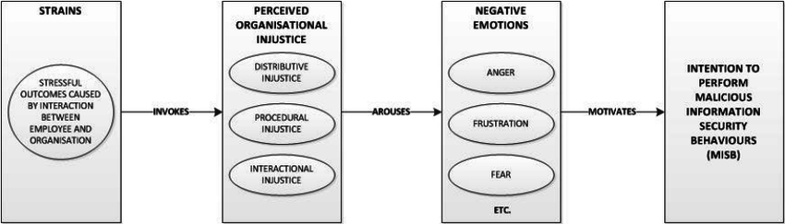

Slide 27
General Strain Theory
Strain: “Goal blockage” – The inability of individuals to achieve their goals.
A disjunction between aspirations and expectations: Wanting to be rich but never getting there.
A disjunction between aspirations and justice: Wanting to be rich but never being paid what you deserve (in your estimation.)
Stressors of disappointment, frustration, dissatisfaction.
See: Elliot Rodger
Final Video

Slide 28
General Strain Theory
Strain: The presentation of noxious or negatively valued stimuli.
Disconnection: Bullying by peers, issues with parents/teachers, frequently victimized by criminals, seen as undesirable or an outlier in society.
Stressors of frustration, disconnection, dissatisfaction.
See: Lane Davis
Reddit history

Slide 29
General Strain Theory
Strain: The loss of a positively valued stimuli.
Personal loss: Something personal lost/stolen, a bad break-up, death of someone close.
Stressors of grief, anger, frustration, feelings of inadequacy, depression.
See: Breivik, Tarrant, Crusius (note eco-fascists generally do not suicide and do not immediately surrender to police)

Slide 30
Social Learning Theory
Also known as Differential Association Theory.
No one is born a criminal. They may be born with a propensity for criminal / deviant behavior. At some point they must learn from someone how to be a criminal.
That is reductive in essence but makes more sense when you introduce the concept of “reciprocal determinism.”

Slide 31
Differential Association Theory
Criminal behavior is learned
It is learned in interaction with others
It is learned within intimate groups
When it is learned, it includes
Techniques for committing the crime
Rationalizations, attitudes, motives
A learned person expresses deviant behavior due to learned favorability to violation of the law
Associations may vary in frequency and intensity

Slide 32
Differential Association Theory
Applying this to computer crime – the associations you keep online either provide favorable or unfavorable attitudes on the law, and contain all of the requisite information to commit the offense. This is also a theory in child exploitation cases, known as the Cycle of Violence.

Slide 33
Differential Associations Example
You are an avid movie lover. You have a collection of hundreds of DVDs. So many that you couldn’t possibly take them all with you as you go off to college. You have a great idea – convert them to digital!
You’re not sure how to do that, so you start looking online and find a forum where people are talking about defeating DRM. They are also talking about how right of ownership.
Next thing you know, you found a post that describes all the steps in detail, and before long you are ripping DVDs with DRM.

Slide 34
Reciprocal Determinism
Reciprocal determinism is a model composed of three factors that influence behavior:
the environment
the individual
the behavior itself
This model suggests that these three components are continually interacting with one another.
Just as the environment exerts an influence on individual behavior, a person's actions also play a part in influencing the environment.

Slide 35
Reciprocal Determinism - Behavior
Behavior influences environment.
For Example: A child who doesn't like school may act out in class, resulting in negative attention from classmates and teachers. The teachers are forced to alter the school environment for this child (and theoretically others like him).

Slide 36
Reciprocal Determinism - Environment
The environment influences the intensity and frequency of the behavior.
For Example: So if our student gets yelled at by a teacher for talking in class, it not only has an effect on him but on the classroom environment for the rest of the students, not to mention the teacher.

Slide 37
Reciprocal Determinism - Individual
Personality and cognitive factors play an important part in how a person behaves, including all of the individual's expectations, beliefs, and unique personality characteristics.
For Example: So all the factors in our troubled student example affect each other: the child doesn't like school, he acts out, his teachers and classmates react to his behavior, reinforcing his dislike of school and creating a hostile environment.

Slide 38
Reciprocal Determinism – Negative Association
If our student is a shy girl who usually keeps to herself (the individual/cognitive component), and enters a room on the first day of class to find that all of the other students are already present (the environment), she might try to slip into the back of the class to avoid becoming the center of attention (the behavioral component).
She feels and acts as an outsider. This impacts the behavior of her peers, who treat her as such (based upon their own components.) Over time, this leads to falling in with a crowd that accepts her, which leads to drug use (Labelling Theory), which leads to other crime.

Slide 39
Reciprocal Determinism – Positive Association
Of course, the situation doesn't have to be a negative one. If our student is a shy girl who usually keeps to herself (the individual/cognitive component), and enters a room on the first day of class to find that all of the other students are already present (the environment), she might try to slip into the back of the class to avoid becoming the center of attention (the behavioral component).
But if another student at the front of the room boisterously greets our shy girl and invites her to sit down in an adjacent seat, the environment has introduced a new reinforcing stimulus (the friendly student) that could lead to a change in our shy girl's normal routine and a change in her behavior.

Slide 40
Space Transition Theory
Social norms are conditions of the social contract. Violation of that contract is reinforced by stigma. Criminal violations are punished by law.
Virtual environments do not make that reinforcement as direct.
Identity flexibility / relative anonymity
Lack of deterrence / oversight

Slide 41
Space Transition Theory
Persons with repressed criminal behavior have a propensity to commit crime in cyberspace which they would not otherwise commit.
Persons from a closed society are more likely to engage in criminal behavior online.
A conflict of norms between what is considered deviant in real life verses what is considered deviant online may lead to crimes.

Slide 42
Space Transition Theory
Offenders are likely to engage in intermittent ventures – strangers will band together for a common criminal enterprise.
Hacker collectives
Many state-actors are freelancers or unofficially affiliated

Slide 43
Final Note on Theories
You should understand that there is no one “correct” theory, and often multiple theories apply .
A person, under strain (GST), in a family that commonly engages in deviant/criminal behavior (SLT), who frequently sees such deviant/criminal behavior go unpunished (BWT), and already suffers from anger/depression (B-ST), is FAR more likely to engage in deviant/criminal behavior if the opportunity to do so presents itself (RAT.)

